Slide 1


Copyright © by Passive System Alliance | All rights reserved.

Slide 2
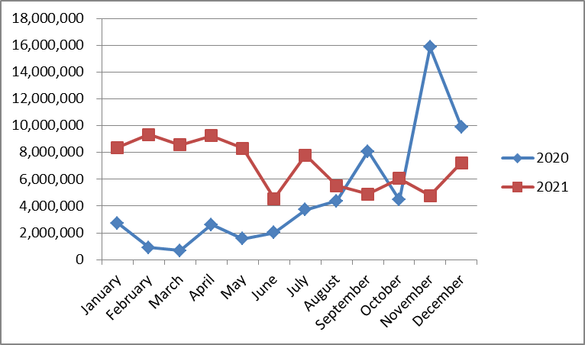
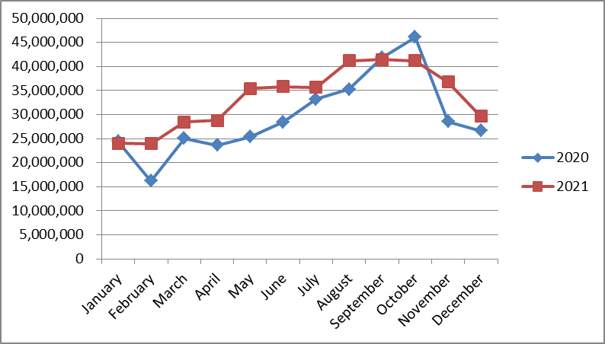
總表
 | 2019年 | 2020年 | 成長率 | 2021年 | 成長率
元件 | 304,064,641 | 354,654,392 | 117% | 402,419,871 | 13%
天線 | 24,675,616 | 56,953,711 | 231% | 84,664,094 | 49%
RF/總金額
Component/總金額

Slide 3
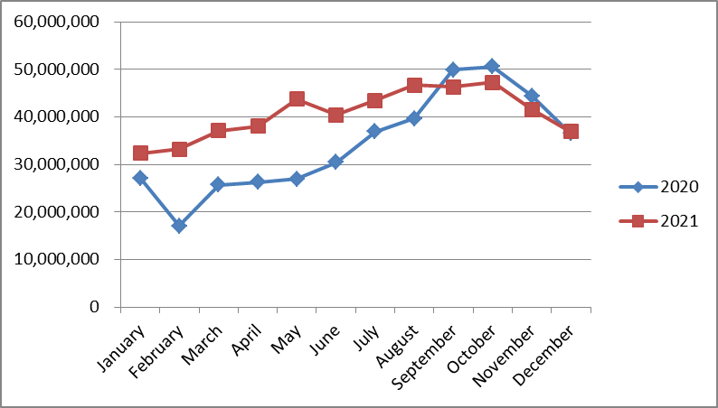
OED/OED TEAM整體業績/預算
Month | 2020 | 2021
January | 27,146,524 | 32,387,974
February | 17,108,471 | 33,252,842
March | 25,716,597 | 37,066,527
April | 26,300,480 | 38,034,077
May | 26,971,671 | 43,753,840
June | 30,451,019 | 40,415,407
July | 36,940,011 | 43,477,177
August | 39,670,159 | 46,709,664
September | 49,882,938 | 46,310,608
October | 50,586,855 | 47,246,749
November | 44,447,437 | 41,560,568
December | 36,561,054 | 36,868,534
Total | 411,783,215 | 487,083,966

Slide 4
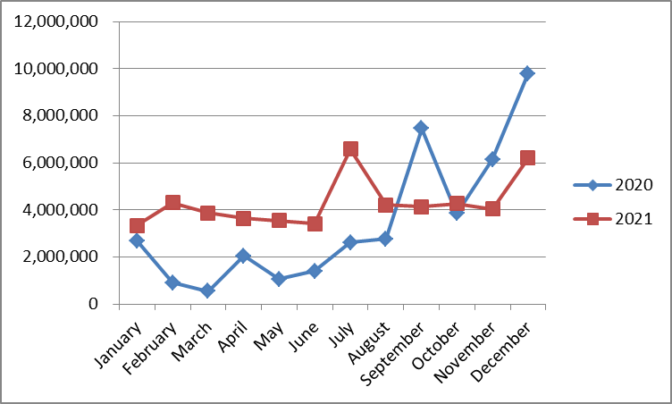
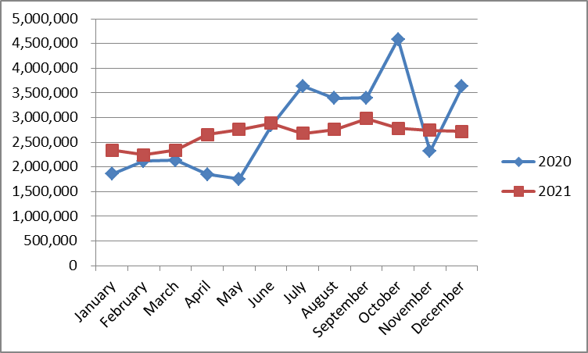
Russia
 | 2019年 | 2020年 | 成長率 | 2021年 | 成長率
元件 | 25,940,003 | 33,530,197 | 129% | 31,887,231 | -5%
天線 | 19,137,937 | 41,286,005 | 216% | 51,543,521 | 25%
RF/總金額
Component/總金額

Slide 5
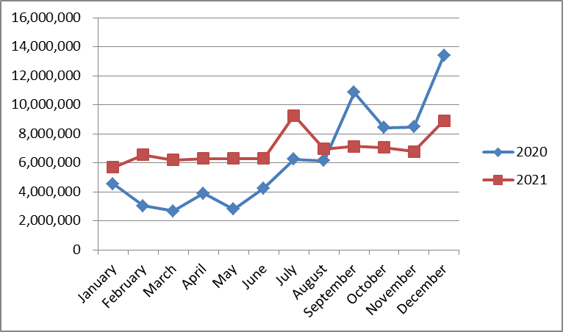
Russia整體業績/預算
Month | 2020 | 2021
January | 4,549,644 | 5,685,169
February | 3,038,591 | 6,547,128
March | 2,679,917 | 6,201,288
April | 3,895,774 | 6,293,963
May | 2,811,315 | 6,303,264
June | 4,245,858 | 6,301,487
July | 6,256,773 | 9,257,255
August | 6,153,263 | 6,959,287
September | 10,860,647 | 7,124,772
October | 8,437,844 | 7,050,621
November | 8,467,821 | 6,792,172
December | 13,418,753 | 8,914,345
Total | 74,816,202 | 83,430,752

Slide 6
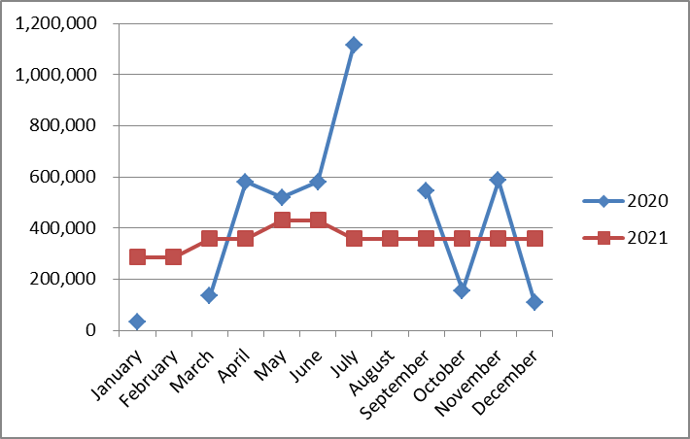
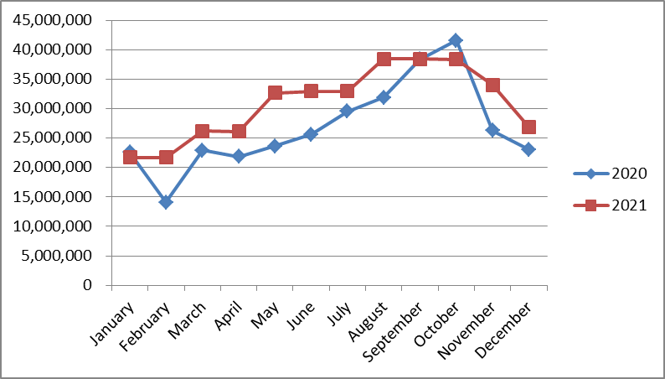
OEM/ODM
 | 2019年 | 2020年 | 成長率 | 2021年 | 成長率
元件 | 25,940,003 | 33,530,197 | 129% | 31,887,231 | -5%
天線 | 19,137,937 | 41,286,005 | 216% | 63,514,513 | 54%
RF/總金額
Component/總金額

Slide 7
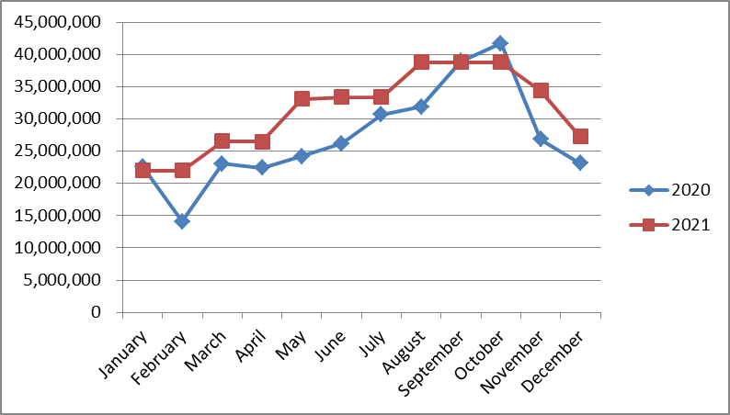
OEM/ODM整體業績/預算
Month | 2020 | 2021
January | 22,596,880 | 21,971,145
February | 14,069,881 | 21,971,145
March | 23,029,208 | 26,523,228
April | 22,404,706 | 26,484,362
May | 24,160,355 | 33,108,564
June | 26,174,787 | 33,397,769
July | 30,683,237 | 33,343,720
August | 31,901,893 | 38,804,335
September | 38,939,818 | 38,804,335
October | 41,698,829 | 38,755,387
November | 26,848,774 | 34,386,895
December | 23,142,301 | 27,280,232
Total | 325,650,668 | 374,831,119

Slide 8
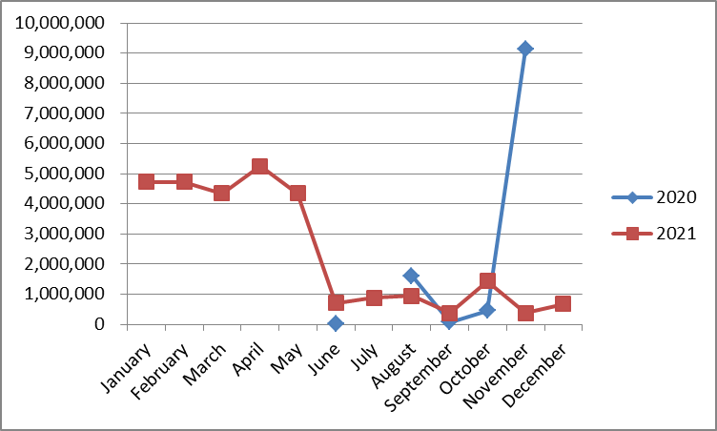
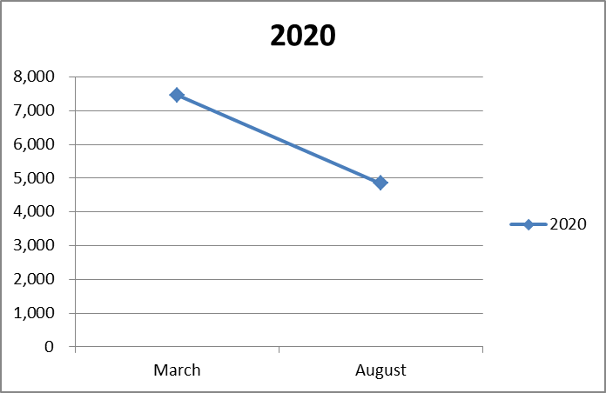
INDIA
 | 2019年 | 2020年 | 成長率 | 2021年 | 成長率
元件 | 9,267 | 12,319 | 133% | 0 | -100%
天線 | 202,192 | 11,304,026 | 5591% | 28,822,095 | 155%
RF/總金額
Component/總金額

Slide 9
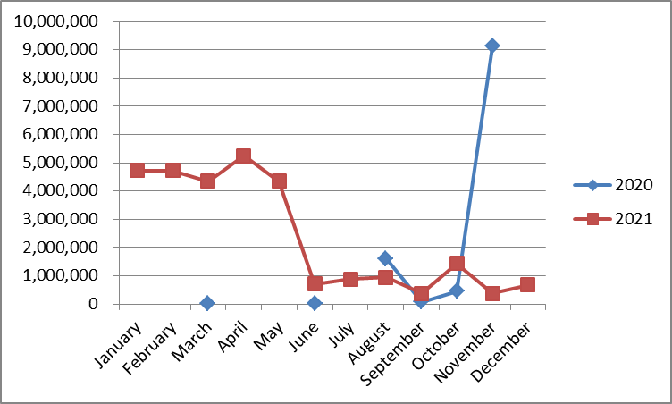
INDIA整體業績/預算
Month | 2020 | 2021
January |  | 4,731,660
February |  | 4,734,570
March | 7,472 | 4,342,011
April |  | 5,255,751
May |  | 4,342,011
June | 30,373 | 716,151
July |  | 876,201
August | 1,615,002 | 946,041
September | 82,473 | 381,501
October | 450,183 | 1,440,741
November | 9,130,842 | 381,501
December |  | 673,956
Total | 11,316,345 | 28,822,095

Slide 10
Thank you

Slide 11
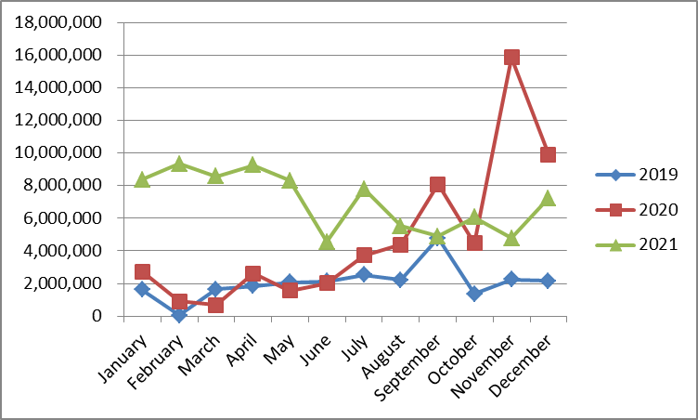
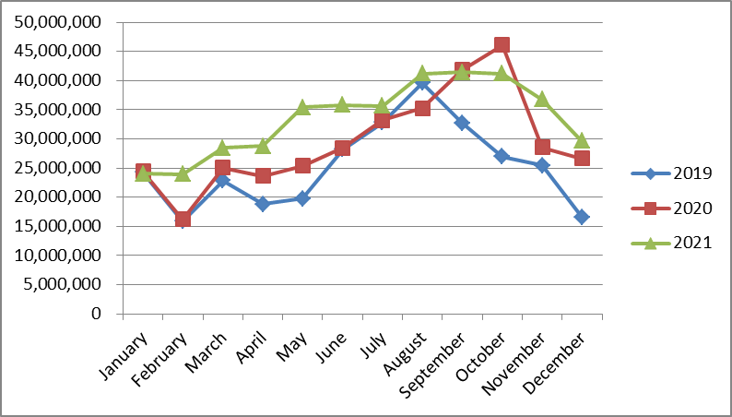
總表
 | 2019年 | 2020年 | 成長率 | 2021年 | 成長率
元件 | 304,064,641 | 354,654,392 | 117% | 402,419,871 | 13%
天線 | 24,675,616 | 56,953,711 | 231% | 84,664,094 | 49%
RF/總金額
Component/總金額

Slide 12
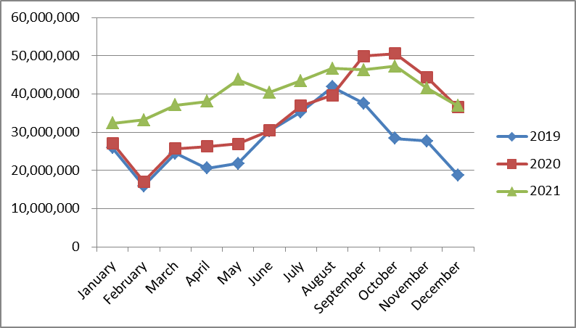
OED/OED TEAM整體業績/預算
Month | 2019 | 2020 | 2021
January | 25,854,965 | 27,146,524 | 32,387,974
February | 15,938,064 | 17,108,471 | 33,252,842
March | 24,500,861 | 25,716,597 | 37,066,527
April | 20,623,562 | 26,300,480 | 38,034,077
May | 21,839,943 | 26,971,671 | 43,753,840
June | 30,333,264 | 30,451,019 | 40,415,407
July | 35,337,537 | 36,940,011 | 43,477,177
August | 41,876,530 | 39,670,159 | 46,709,664
September | 37,537,432 | 49,882,938 | 46,310,608
October | 28,359,088 | 50,586,855 | 47,246,749
November | 27,747,244 | 44,447,437 | 41,560,568
December | 18,791,767 | 36,561,054 | 36,868,534
Total | 328,740,257 | 411,783,215 | 487,083,966

Slide 13
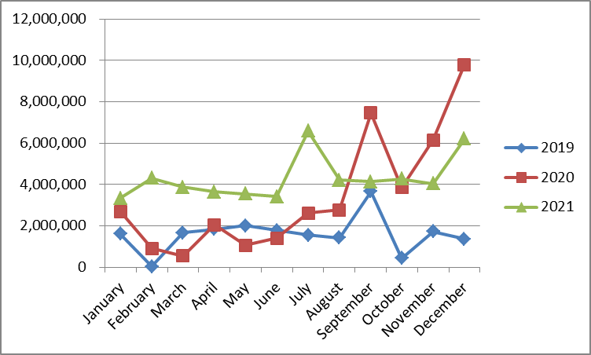
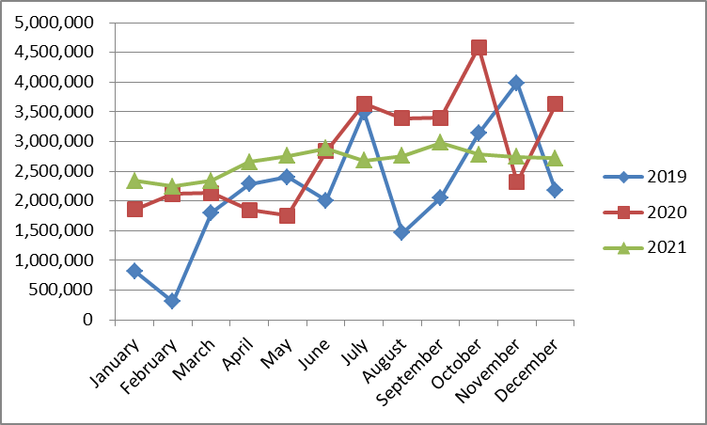
Russia
 | 2019年 | 2020年 | 成長率 | 2021年 | 成長率
元件 | 25,940,003 | 33,530,197 | 129% | 31,887,231 | -5%
天線 | 19,137,937 | 41,286,005 | 216% | 51,543,521 | 25%
RF/總金額
Component/總金額

Slide 14
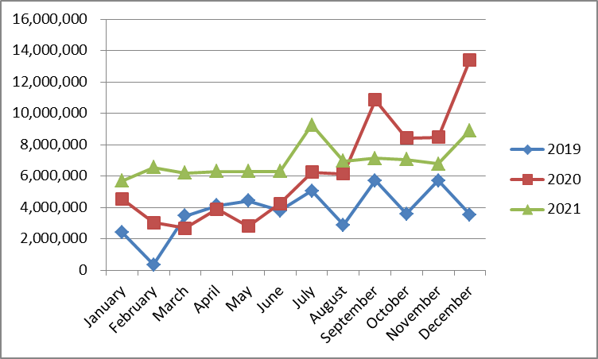
Russia整體業績/預算
Month | 2019 | 2020 | 2021
January | 2,434,615 | 4,549,644 | 5,685,169
February | 351,304 | 3,038,591 | 6,547,128
March | 3,459,919 | 2,679,917 | 6,201,288
April | 4,121,187 | 3,895,774 | 6,293,963
May | 4,418,977 | 2,811,315 | 6,303,264
June | 3,794,357 | 4,245,858 | 6,301,487
July | 5,048,363 | 6,256,773 | 9,257,255
August | 2,892,931 | 6,153,263 | 6,959,287
September | 5,722,167 | 10,860,647 | 7,124,772
October | 3,580,561 | 8,437,844 | 7,050,621
November | 5,718,210 | 8,467,821 | 6,792,172
December | 3,535,349 | 13,418,753 | 8,914,345
Total | 45,077,940 | 74,816,202 | 83,430,752

Slide 15
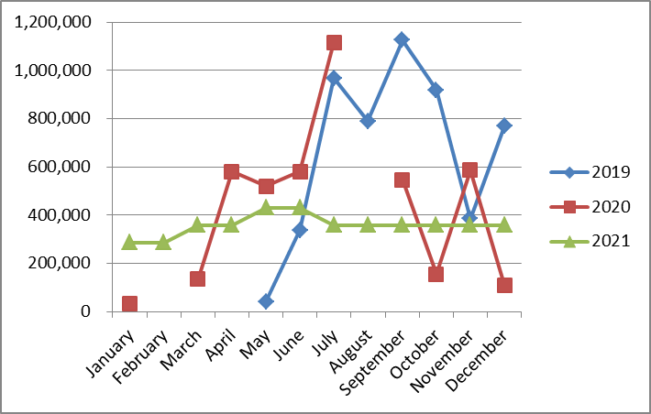
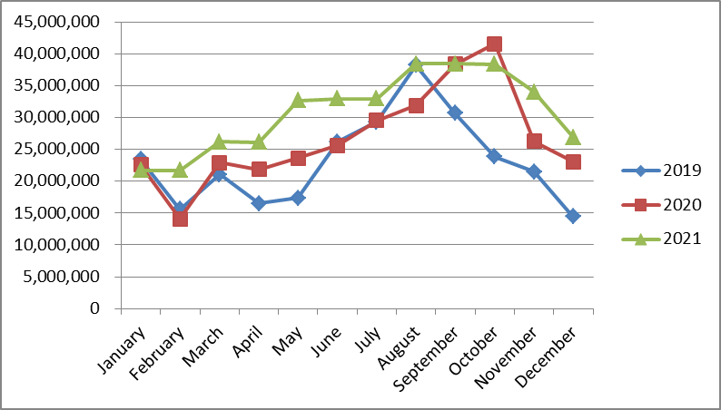
OEM/ODM
 | 2019年 | 2020年 | 成長率 | 2021年 | 成長率
元件 | 25,940,003 | 33,530,197 | 129% | 31,887,231 | -5%
天線 | 19,137,937 | 41,286,005 | 216% | 63,514,513 | 54%
RF/總金額
Component/總金額

Slide 16
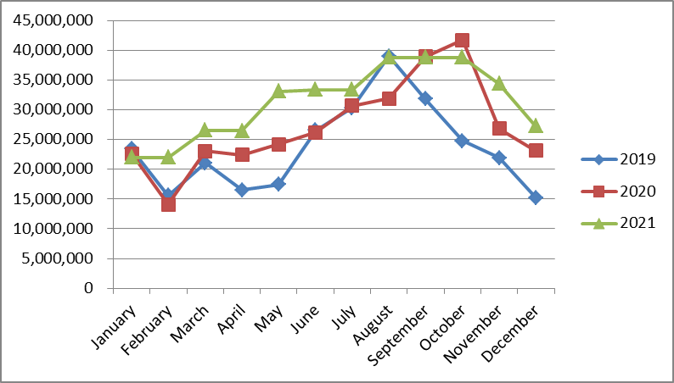
OEM/ODM整體業績/預算
Month | 2019 | 2020 | 2021
January | 23,420,350 | 22,596,880 | 21,971,145
February | 15,586,760 | 14,069,881 | 21,971,145
March | 21,040,941 | 23,029,208 | 26,523,228
April | 16,494,676 | 22,404,706 | 26,484,362
May | 17,405,869 | 24,160,355 | 33,108,564
June | 26,538,907 | 26,174,787 | 33,397,769
July | 30,289,174 | 30,683,237 | 33,343,720
August | 38,983,599 | 31,901,893 | 38,804,335
September | 31,815,265 | 38,939,818 | 38,804,335
October | 24,769,260 | 41,698,829 | 38,755,387
November | 21,890,055 | 26,848,774 | 34,386,895
December | 15,216,003 | 23,142,301 | 27,280,232
Total | 283,450,858 | 325,650,668 | 374,831,119

Slide 17
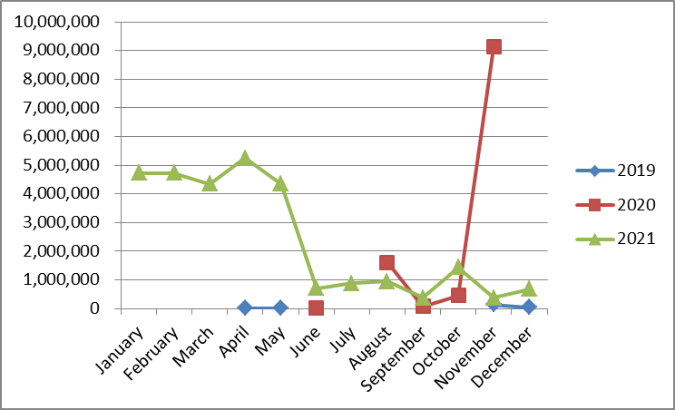
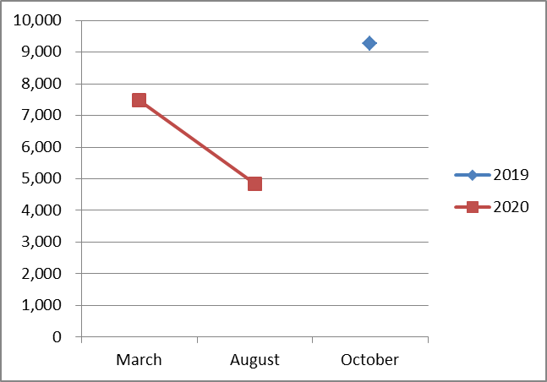
INDIA
 | 2019年 | 2020年 | 成長率 | 2021年 | 成長率
元件 | 9,267 | 12,319 | 133% | 0 | -100%
天線 | 202,192 | 11,304,026 | 5591% | 28,822,095 | 155%
RF/總金額
Component/總金額

Slide 18
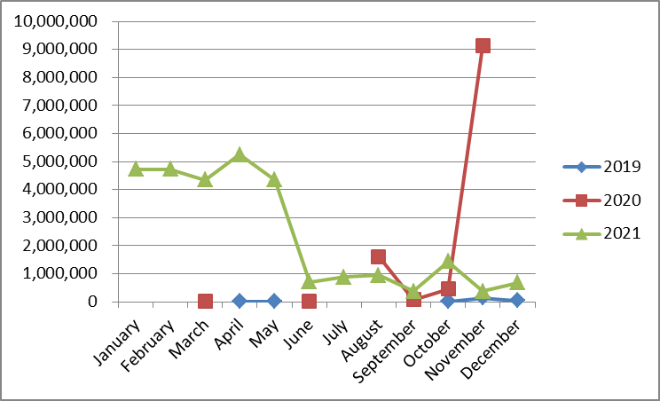
INDIA整體業績/預算
Month | 2019 | 2020 | 2021
January |  |  | 4,731,660
February |  |  | 4,734,570
March |  | 7,472 | 4,342,011
April | 7,699 |  | 5,255,751
May | 15,098 |  | 4,342,011
June |  | 30,373 | 716,151
July |  |  | 876,201
August |  | 1,615,002 | 946,041
September |  | 82,473 | 381,501
October | 9,267 | 450,183 | 1,440,741
November | 138,980 | 9,130,842 | 381,501
December | 40,415 |  | 673,956
Total | 211,459 | 11,316,345 | 28,822,095

